Slide 1


Life Expectancy Analysis
Alisha Baral
MSDS690
Data Science Practicum I
Regis University
02/28/2023

Slide 2

Background
Life Expectancy is a statistical measure that represents the average number of years a person is expected to live based on various factors, including, age, gender, lifestyle.
The factors are usually income, education, access to healthcare and social and cultural norms that play a significant role.

Slide 3
About this data
Life expectancy data was collected from WHO and United Nations website.
This data shows the life expectancy, health factors for 193 countries from 2000-2015 where the chosen health factors are the critical factors which affects the life expectancy more.
The predicting variables were divided into several broad categories like social, economic, mortality, and immunization related factors.
Some fewer known countries with a lot of missing values were not considered for this data

Slide 4
Research question
What factors are most strongly associated with life expectancy?
Can we identify specific diseases or health conditions that have had a significant impact on life expectancy?
How does life expectancy vary by country or region, and what factors explain these differences?
Does machine learning algorithms help predict life expectancy for individuals or populations?

Slide 5
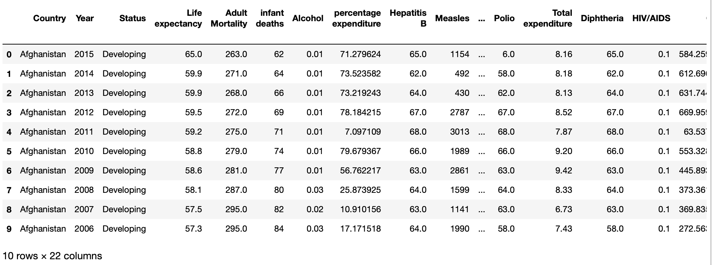
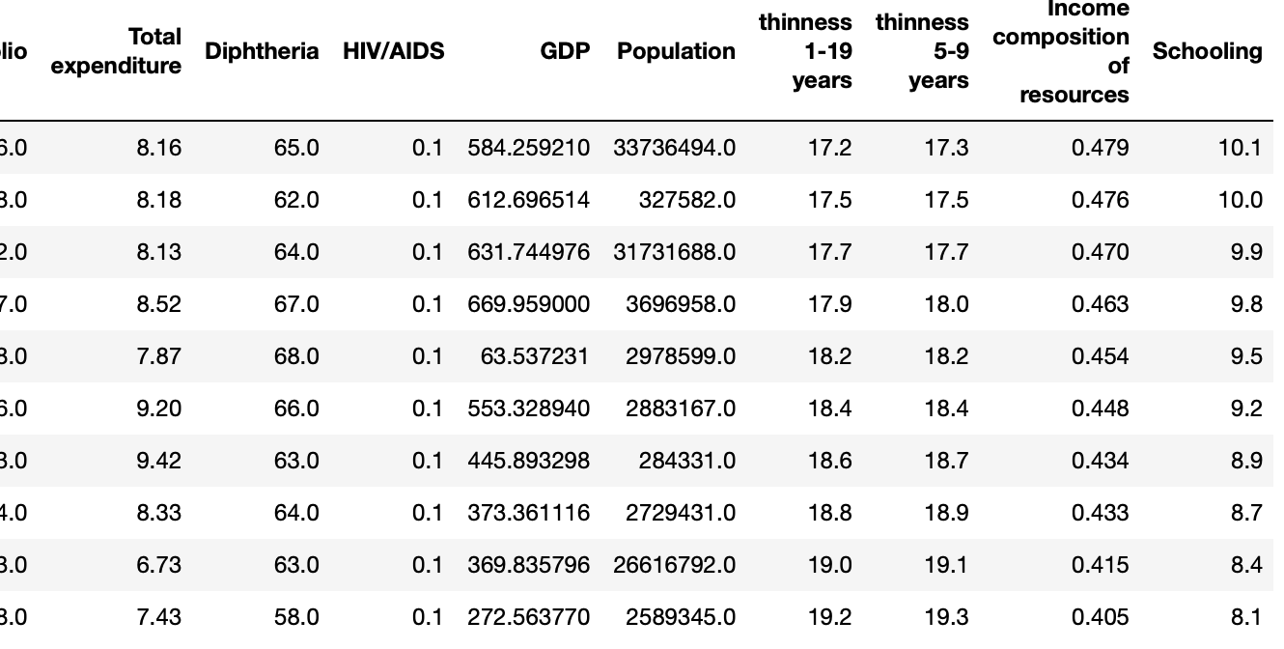
How does the data look like?

Slide 6

Data Preprocessing and EDA finding

Slide 7
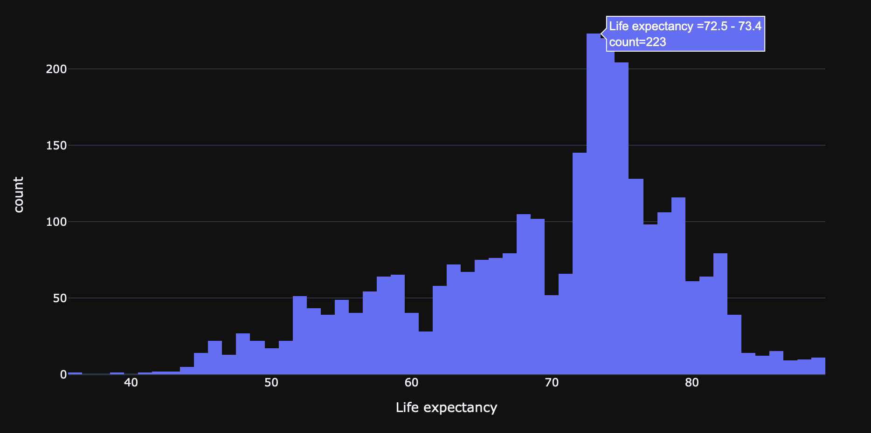
Plotting individual attributes of the dataframe

Slide 8
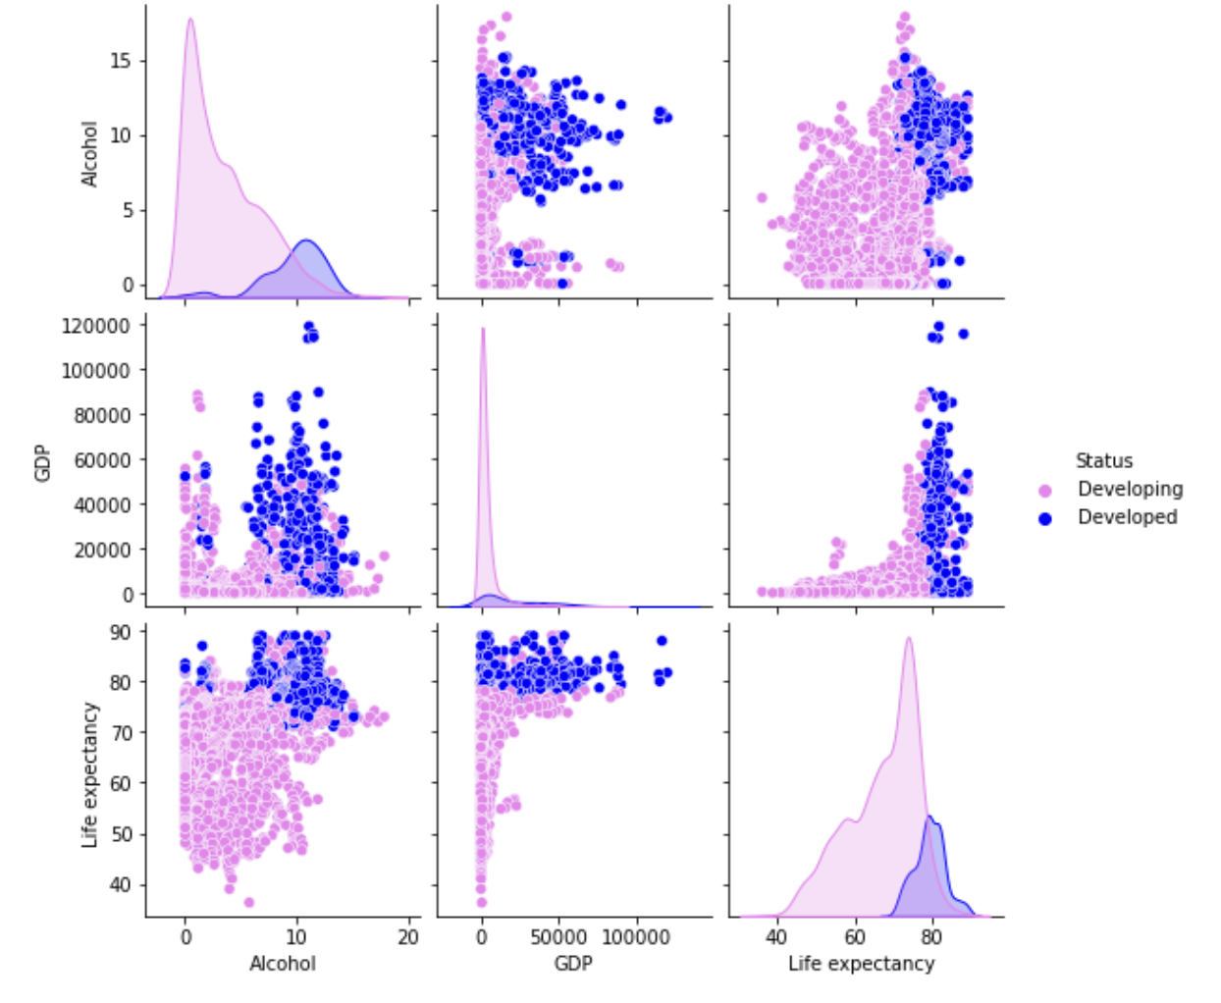
Plotting multiple variable

Slide 9
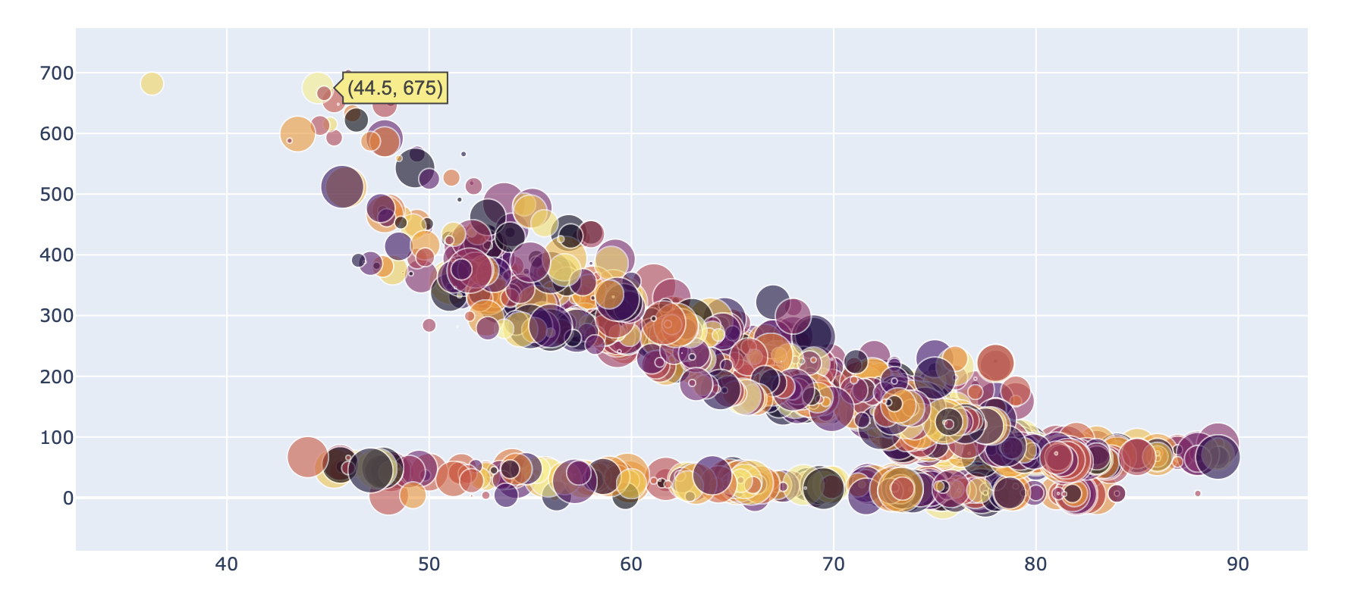
Plotting life expectancy and adult mortality across all countries

Slide 10
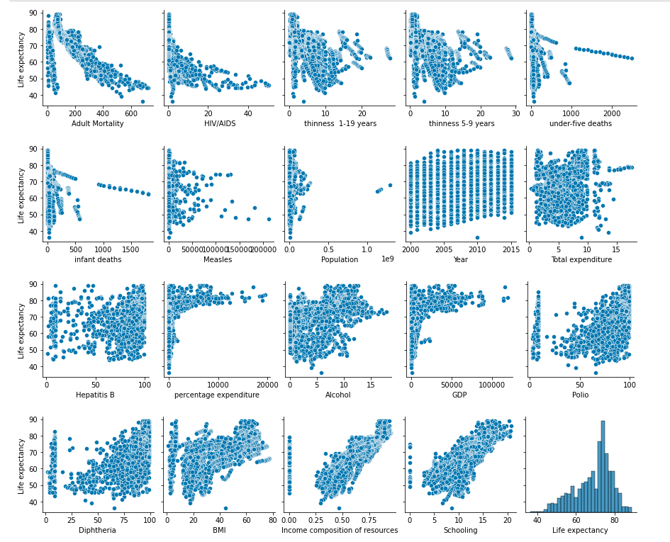
Visualization correlation between life expectancy with every other variable
Notes:
.

Slide 11
Data cleaning and dividing into training and test

Slide 12

Predicting Model
Linear regression
Multi Linear Regression
Decision Tree Regression
Decision Tree Regression 2

Slide 13
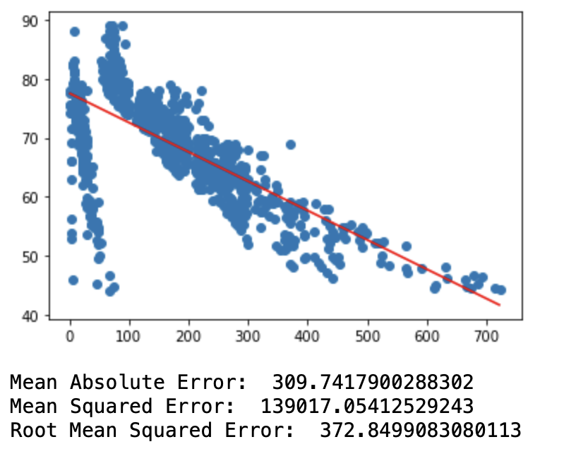
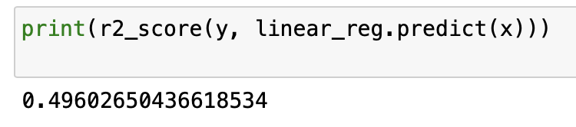
Linear regression

Slide 14
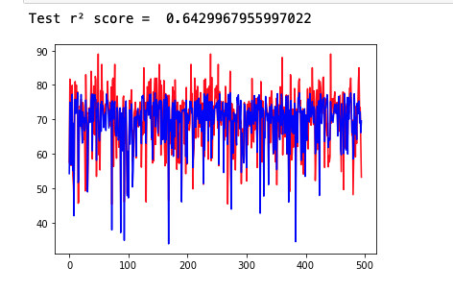
Multi Linear Regression

Slide 15
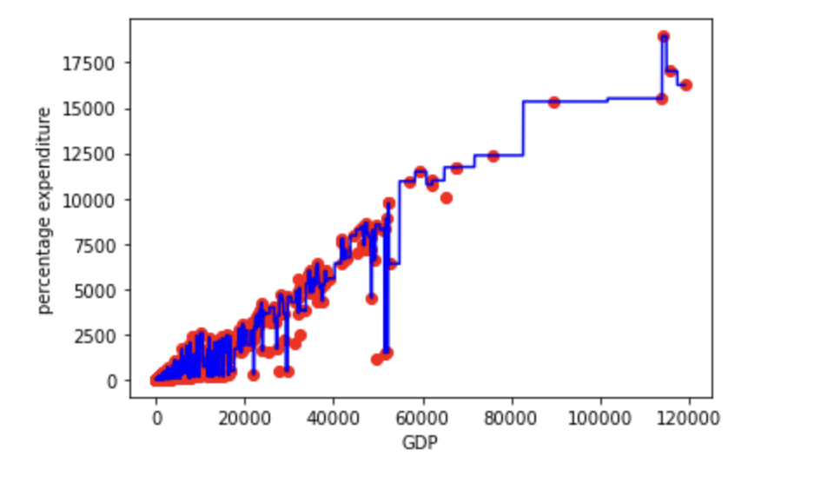
Decision Tree 1

Slide 16
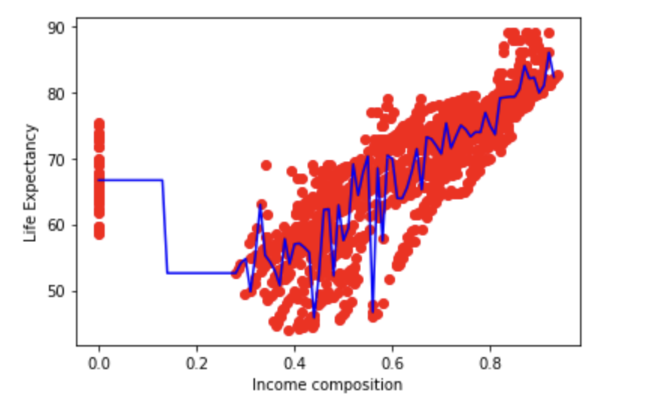
Decision Tree 2
Notes:
.

Slide 17

Conclusion and Findings
Multi-linear regression model was found to provide a good fit to the test data.
Decision tree models demonstrated high accuracy in pretending percentage expenditure based on GDP and life expectancy based on income composition, respectively.
Adult Mortality, HIV/AIDS, thinness and under-five deaths increases drops the life expectancy

Slide 18
Reference
KumarRajarshi. (2018, February 10). Life expectancy (WHO). Kaggle. Retrieved February 28, 2023, from https://www.kaggle.com/datasets/kumarajarshi/life-expectancy-who
Ortiz-Ospina, E. (2017, August 28). "Life expectancy" – what does this actually mean? Our World in Data. Retrieved February 28, 2023, from https://ourworldindata.org/life-expectancy-how-is-it-calculated-and-how-should-it-be-interpreted

